Slide 1



Dynamics
EXPLORING THE CAUSES OF DECLINING BIRTH RATES IN SOUTH KOREA
Javlonbek 12194926
Shokirjon 12194867
Jakhongir 12210220

Slide 2
CONTENTS
01
02
03
Why did we choose this topic?
Reasons for decline
Benefits to Society
04
05
06
Data analysis tool
Statistics
Statistics 2

Slide 3





THE REASONS FOR CHOOSING THIS TOPIC
INTEREST AND CURIOSITY
IMPACT ON SOCIETY
Exploration offers insights into human behavior and cultural dynamics.
72 children have been born for every 100 couples (200 people).
Consequences span economy, healthcare, and social welfare.
Understanding drives policy development to mitigate negatives.

Slide 4
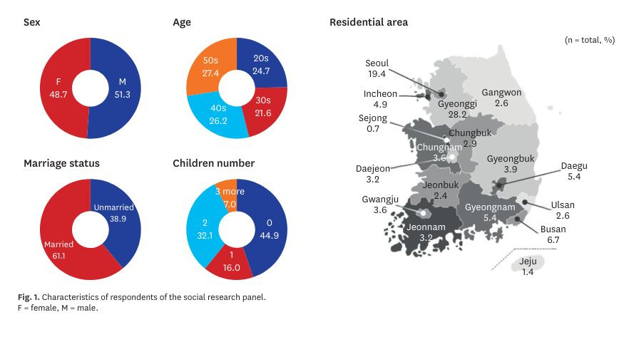

Slide 5
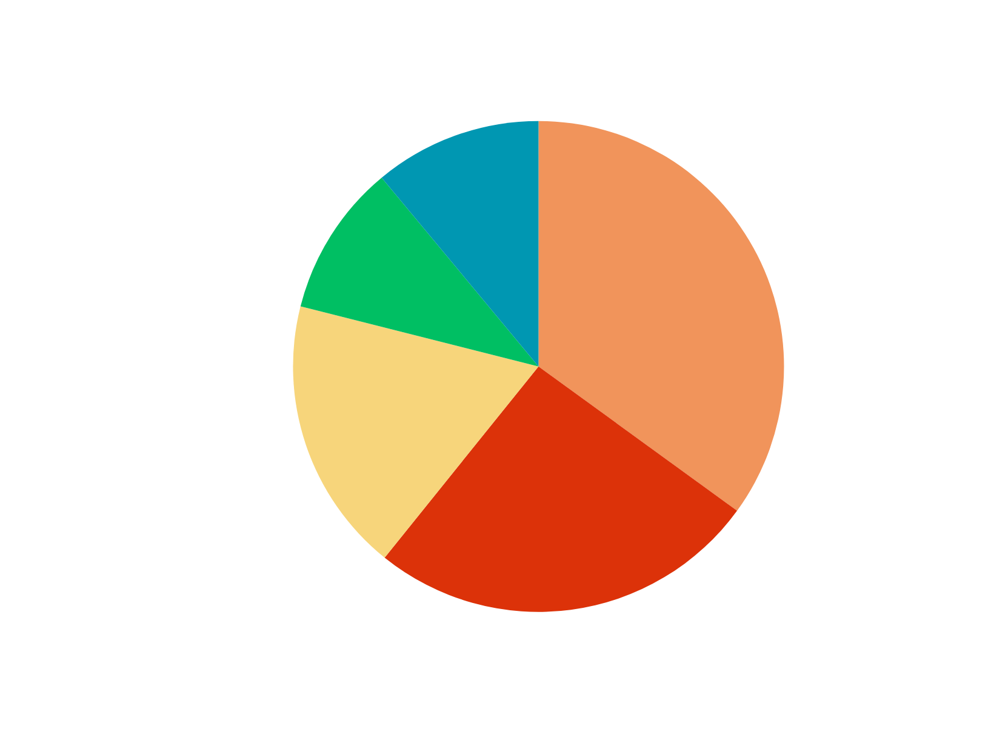
REASONS FOR LOW FERTILITY
regardless of gender*

Slide 6





BENEFITS TO SOCIETY
Economic stability
Solving this problem may contribute to economic stability:
Labor shortages
Declining productivity

Slide 7


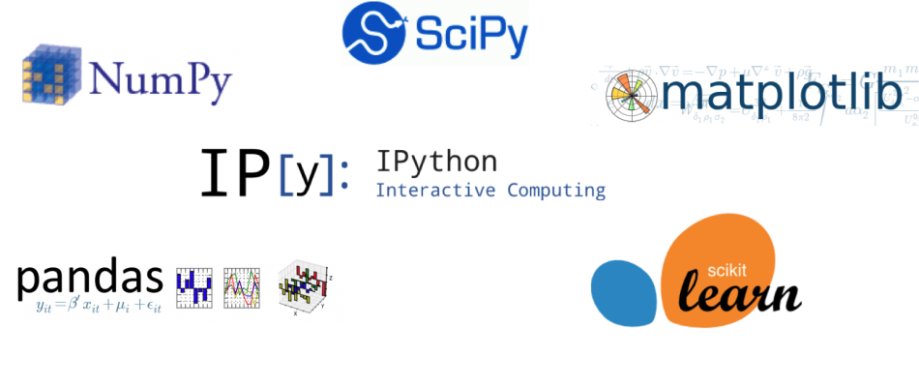
Data analysis Tools:
Python
Matplotlib
Numpy

Slide 8
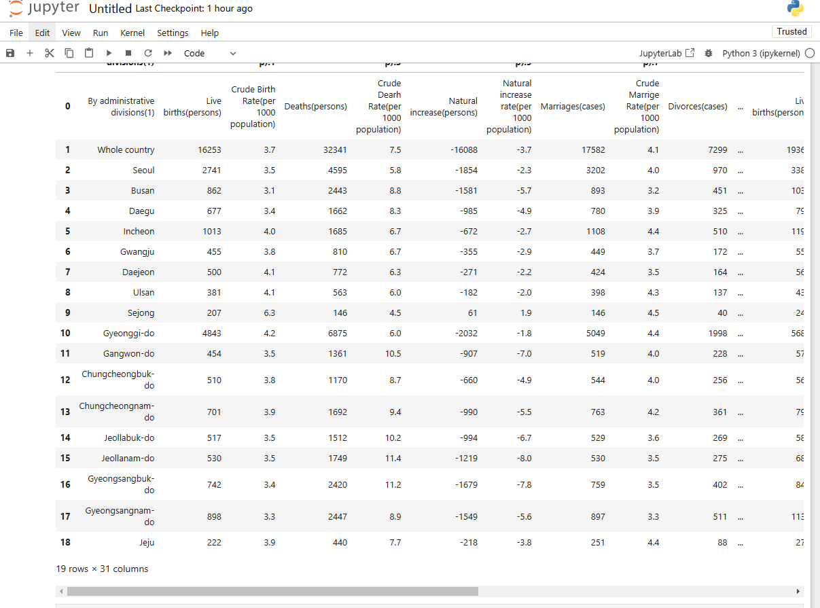
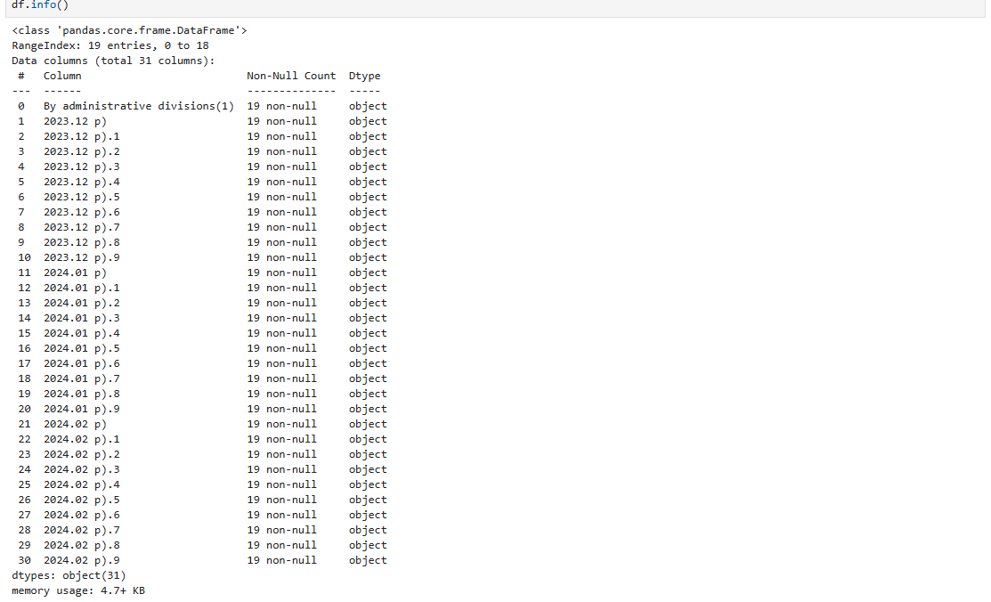
STATISTICS

Slide 9
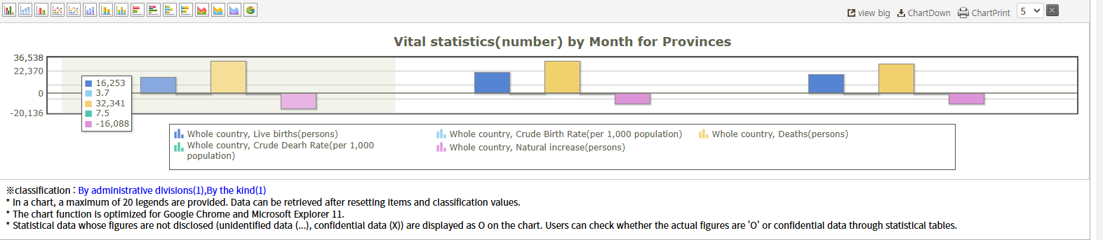
STATISTICS

Slide 10

Dynamics
Thank you for your attention
If you have any questions, feel free to ask!

Slide 11
References
1. Statistics Korea. Results of birth and death statistics in 2020. http://kostat.go.kr/portal/korea/kor_nw/1/2/3/ index.board?bmode=read&bSeq=&aSeq=388265&pageNo=1&rowNum=10&navCount=10&currPg=& searchInfo=&sTarget=title&sTxt=. Updated 2021. Accessed March 20, 2021.
2. Kang DS, Kim MG, Kim JI, Lee SY, Lee SL, Lee KH, et al. Integrated Policy Measures to Respond to the Low Fertility Rate. National Research Council for Economics Humanities and Social Sciences Collaborative Research Series 20- 16-01. Seoul, Korea: National Research Council for Economics Humanities and Social Sciences; 2021.
3. Presidential Committee on Ageing Society and Population Policy. The Fourth Plan on Low Birth and Ageing Society (2021–2025). Sejong, Korea: Ministry of Health and Welfare; 2020.
4. Kim KS, Heo GH, Kim YS, Kim SM. Analysis of Current Economic Issues No. 94: Causes and Economic Impact of the Low Fertility Rate in Korea. Seoul, Korea: National Assembly Budget Office; 2018.
5. Kim JH, Lee SY, Choi IS. A Study on Necessity and Feasibility of a New Panel Dataset for Population Policy. Sejong, Korea: Korea Institute for Health and Social Affairs; 2018.
6. Won JW, Lee SY. Analysis of Effectiveness of Low Fertility Policy. Sejong, Korea: Korea Institute for Health and Social Affairs; 2017.
7. Kim SW. Low Fertility Measure Evaluation II (Priority of Policy). Seoul, Korea: National Assembly Budget Office; 2016.

